Slide 1
Education, Poverty and Terrorism: Is there a Causal Connection?
Alan. B. Krueger and Jitka Maleckova
-Prajvini S P

Slide 2
Post Sep 11th, policy makers and scholars felt the need to increase access to education and alleviate poverty to contain terrorism.
Terrorism is difficult to define.
The term “terrorism” means premeditated, politically motivated violence perpetrated against noncombatant targets by subnational groups or clandestine agents, usually intended to influence an audience. The term “international terrorism” means terrorism involving citizens or the territory of more than one country.
Scholarly definitions include nation states as potential perpetrators of terrorism.

Slide 3
THEORITICAL CONSIDERATIONS
Crime increases as one’s market wage falls relative to the rewards associated with crime.
Individuals are more likely to commit property crimes if they have lower wages or less education. The occurrence of violent crimes, including murders, however, is typically found to be unrelated to economic opportunities.
Political leaders purvey hatred to further their political goals.
How an increase in penalties and law enforcement influences the incentive to partake in terrorist activities.
Other important considerations include the relative pay of skilled and unskilled individuals for participation in terrorist organizations and how it compares to relative pay in the legal sector, and the selection of terrorists by terrorist organizations from the pool of potential applicants. Terrorist organizations may prefer to select those who have better education.

Slide 4
HATE CRIMES
Hate crimes are commonly defined as crimes against members of religious, racial or ethnic groups because of their group membership, rather than their characteristics or actions as individuals. Hate crimes include acts of violence, as well as destruction of property, harassment and trespassing.
A consensus is emerging that views hate crimes as independent of economic deprivation. The existence of hate groups was unrelated to the unemployment rate, divorce rate, percentage black or gap in per capita income between whites and blacks in the county. Eg: US-Klu Klux Klan, Germany
Rather than economic conditions as a cause of hate crimes, this literature points to a breakdown in law enforcement and official sanctioning or encouragement of civil disobedience as potential causes of the occurrence of hate crimes.

Slide 5
Public Opinion Polls in West Bank and Gaza Strip
Public opinion polls can provide indirect information about which segments of the population support terrorist or militant activities.
Clearly, a majority of the Palestinian population favor armed attacks against Israeli targets . By a 68 percentage point margin those with more than a secondary school education support armed attacks against Israeli targets, while the margin is 46 points for those who are illiterate and 63 points for those with an elementary school education.
More highly educated respondents were less supportive of a dialogue with Israel: 53 percent of those with a B.A. degree and 40 percent of those with an M.A. or Ph.D. degree supported a dialogue, compared with 60 percent of those with nine years or less of schooling.
As a whole, the public opinion findings are consistent with Lerner’s classic study of political extremism in six Middle Eastern countries. After examining opinion polls and conducting field work, Lerner concluded, “The data obviate the conventional assumption that the Extremists are simply the ‘have-nots,’ suggesting rather that they are the ‘want-mores’.

Slide 6
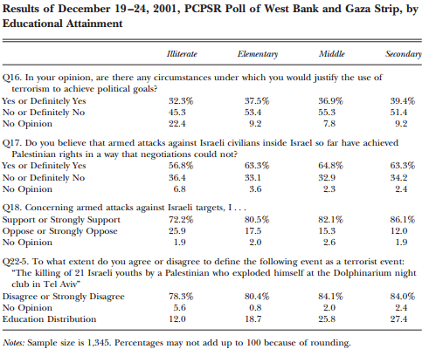
The unemployed are somewhat less likely to support armed attacks against Israeli military, and
especially civilian, targets. If poverty was the wellspring of support for terrorism,
one would have expected the unemployed to be more supportive of armed attacks
than merchants and professionals, not less. Notice also that responses from
housewives are quite similar to those of the general public

Slide 7
Angrist (1995) closely examines trends in school enrollment, earnings and unemployment by level of education in the West Bank and Gaza Strip in a period encompassing the intifada in 1988. He finds that college enrollment increased rapidly in the early 1980s, doubling between 1981 and 1985. Between 1982 and 1988, the number of Palestinian men in the labor force with 12 or more years of schooling doubled, while the number of those with 11 or fewer years of schooling increased only around 30 percent. This remarkable rise in the education of the workforce coincided with a sharp increase in the unemployment rate for college graduates relative to high school graduates in the 1980s. In addition, from 1985 to 1988, the real daily wage of college graduates fell by around 30 percent, while the real wage of those with 12 years of schooling held steady and the real wage of those with 11 or fewer years of schooling increased slightly. Angrist notes that the decline in Palestinian school enrollment in the early 1990s probably represents “a belated supply response to low returns to schooling.”
The Israeli occupation of the territories and lack of an effective capital market or banking system probably prevented the labor markets in the West Bank and Gaza Strip from equilibrating, particularly in light of the fact that many Palestinians are dependent on Israel for jobs

Slide 8
Hezbollah Militant Activities
The Hezbollah (or Hizb’allah, Party of God) was founded in Lebanon in 1982,following the Israeli occupation of southern Lebanon. The original goal of Hezbollah was to fight the Israeli occupation and create a Shiite state in Lebanon, modeled on Iran.
The poverty rate is 28 percent among the Hezbollah militants and 33 percent for the population—that is, 5 points lower for members of the Hezbollah military wing,
It is apparent that the individuals who carried out suicide bomb attacks for these organizations are less likely to come from impoverished families and are much more likely to have completed high school and attended college than the general Palestinian population.
Results suggest that poverty is inversely related with the likelihood that someone becomes a Hezbollah fighter, and education is positively related with the likelihood that someone becomes a Hezbollah fighter.

Slide 9
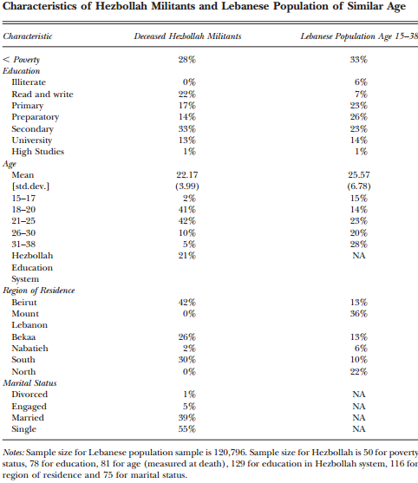

Slide 10
Palestinian Terrorists
Focused on suicide bombers because a common stereotype is that they are the most economically deprived of all the terrorists.
None of them were uneducated, desperately poor, simple minded or depressed. Many were middle class and, unless they were fugitives, held paying jobs. More than half of them were refugees from what is now Israel. Two were the sons of millionaires.”

Slide 11
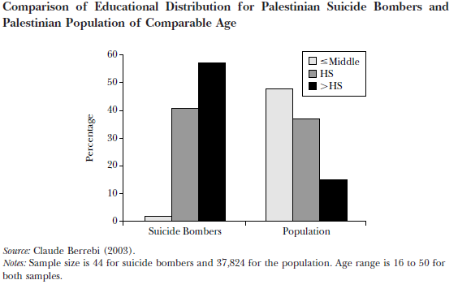

Slide 12
ISRAELI JEWISH UNDERGROUND
These Israeli extremists were disproportionately well-educated and in high-paying occupations. The list includes teachers, writers, university students, geographers, engineers, entrepreneurs, a combat pilot, a chemist and a computer programmer.
KEY FINDINGS
At a given level of income, countries with greater civil liberties—defined by the“freedom to develop views, institutions, and personal autonomy without interference from the state”—are less likely to be a wellspring of international terrorists.
Little direct connection between poverty or education and participation in terrorism. Poverty at the national level may indirectly affect terrorism through the apparent connection between economic conditions and the proclivity for countries to undergo civil wars.

Slide 13
In terms of the supply of terrorists, we hypothesize that terrorism resembles a violent form of political Engagement. More educated people from privileged backgrounds are more likely to participate in politics, probably in part because political involvement requires some minimum level of interest, expertise, commitment to issues and effort, all of which are more likely if people have enough education and income to concern themselves with more than minimum economic subsistence.
Our finding that terrorists are more likely to spring from countries that lack civil rights, if it holds up, is further support for the view that terrorism is a political, not economic, phenomenon.
On the demand side, terrorist organizations may prefer educated, committed individuals. In addition, well-educated, middle- or upper-class individuals are better suited to carry out acts of international terrorism than are impoverished illiterates because the terrorists must fit into a foreign environment to be successful.
If the international community attempts to use education as part of a strategy to reduce terrorism, it should not limit itself to increasing years of schooling, but must also consider the content of education.

Slide 14
Reference
Alan B. Krueger and Jitka Maleckova,(2003); Education, Poverty and Terrorism: Is There a Causal Connection?; Journal of Economic Perspectives—Volume 17, Number 4—Fall 2003—Pages 119–144.

